Slide 1

Street improvement Project (SIP) Tracking at NYC DOT
January 2019

Slide 2
OUTLINE
SIP Portal
1 | Background
2 | Portal Structure
3 | Treatments
4 | Use cases
nyc.gov/dot

Slide 3
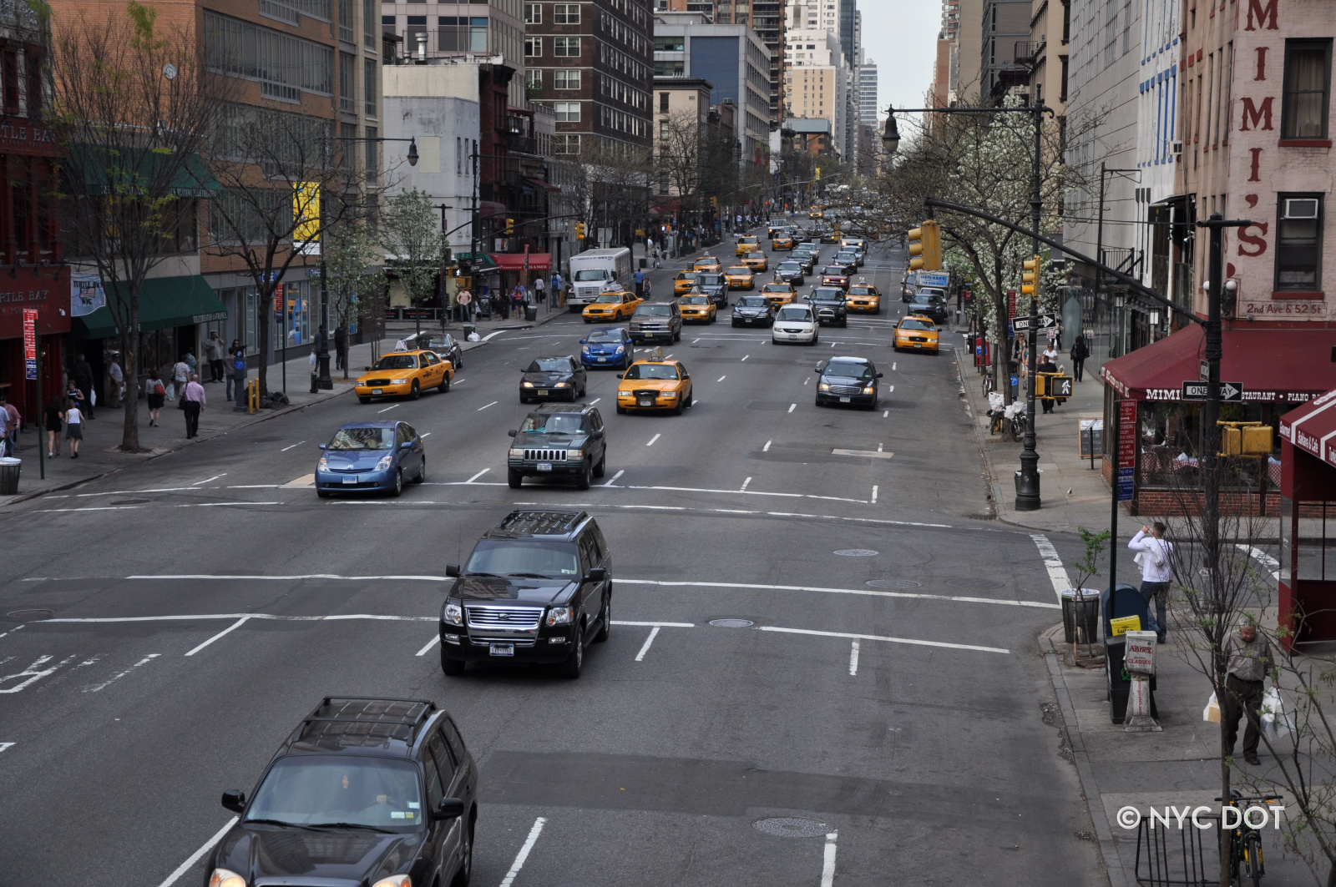
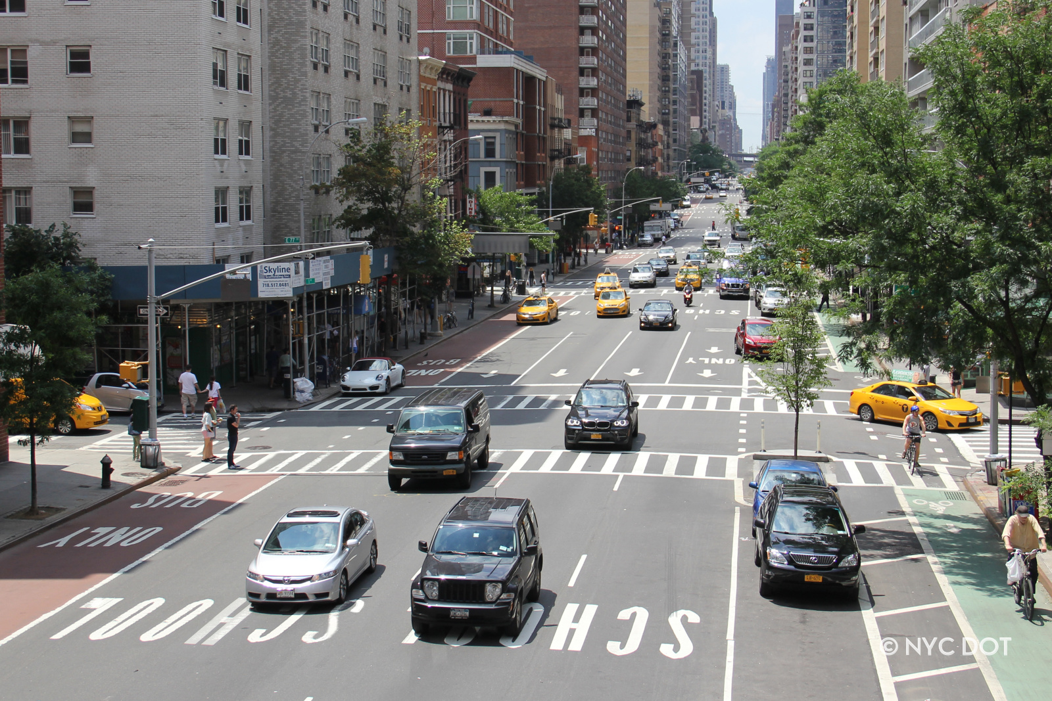
Street Improvement Projects (SIP)
Before
SIP program
+/- 100 projects a year
Implemented by multiple units
Projects types include:
Safety
Bike projects
Transit projects
Freight mobility
Public space
After

Slide 4
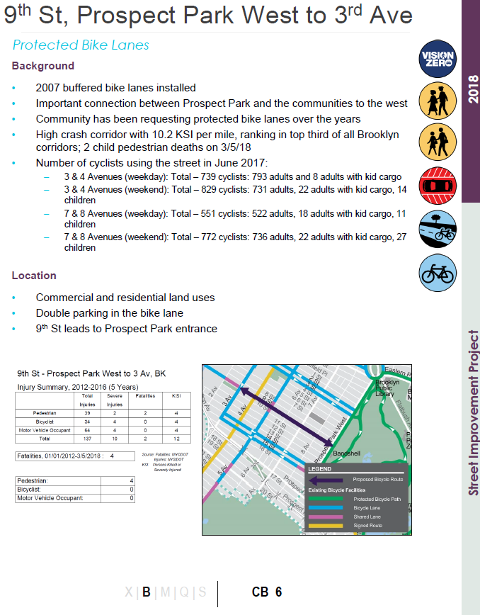
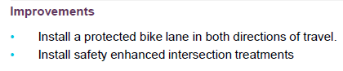
Previous Tracking Methods
3-pager
PPT/PDF
Hardcoded
No GIS data
Some project extents
Often simple trace over Google Maps
Limited treatment data
No Treatment geography
Only high-profile treatments

Slide 5
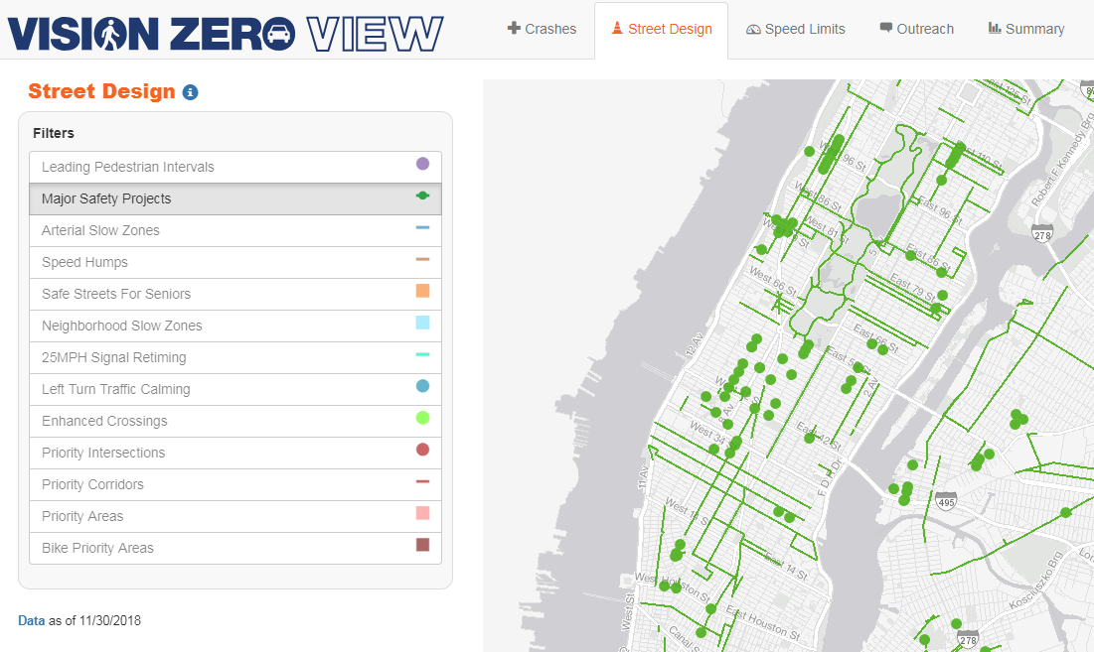
Previous Tracking Methods
RIS SIP Map
Limited Project Extents
Centralized (Arthur)
LION tamed detail
Extents only updated after project complete
No treatment data
Few project attributes

Slide 6
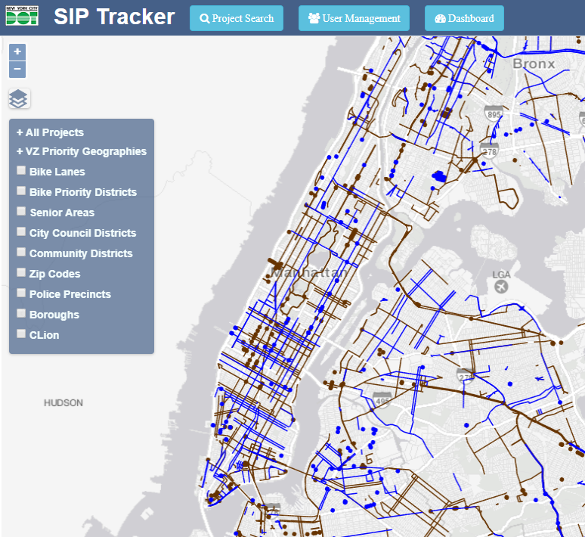
Solution
SIP Portal (“SIP Tracker”)
Decentralized web-map data entry application
Projects & Treatments; Attributes & Geometries
Standardized & customizable treatments
Query-able via PostgreSQL

Slide 7
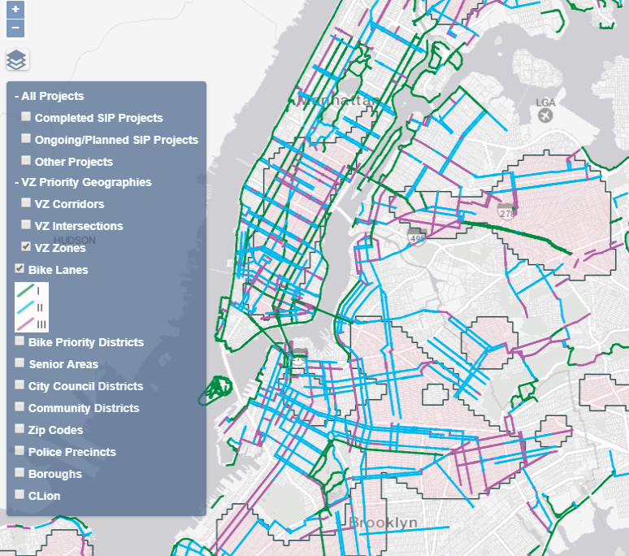
Layers
SIP Portal (“SIP Tracker”)
SIPs mapped
Bike Lanes
Priority Locations
Political Boundaries

Slide 8
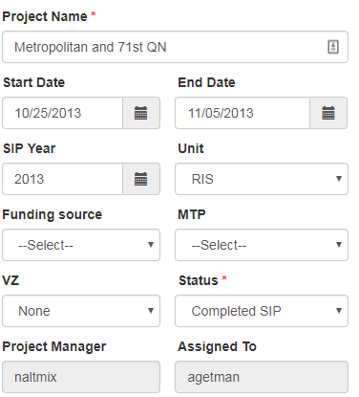
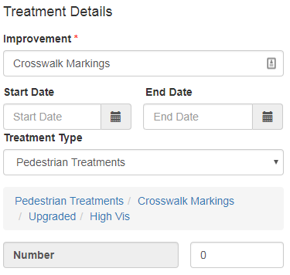
Attributes
Project
Treatment

Slide 9
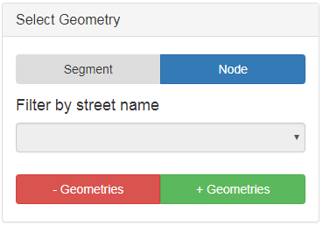
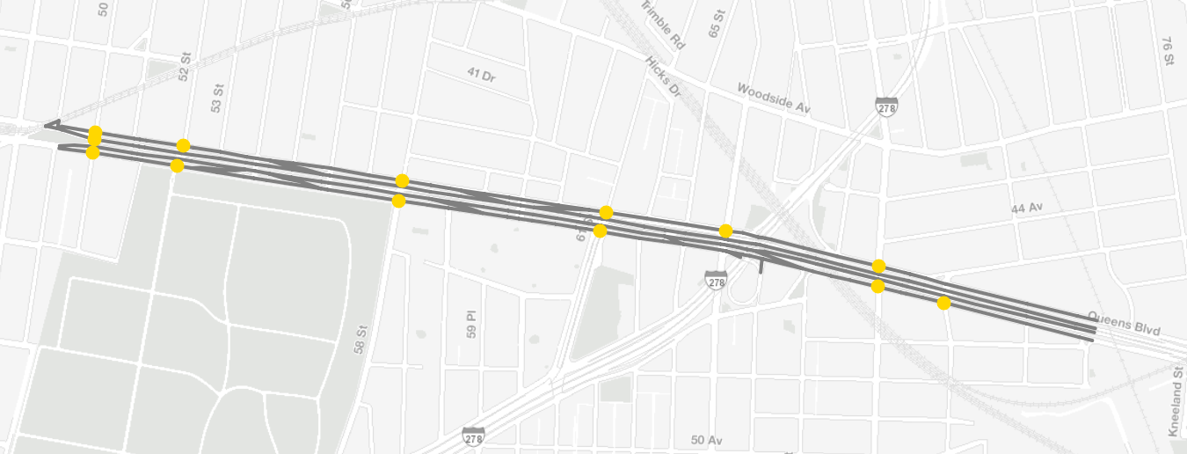
Geometry

Slide 10
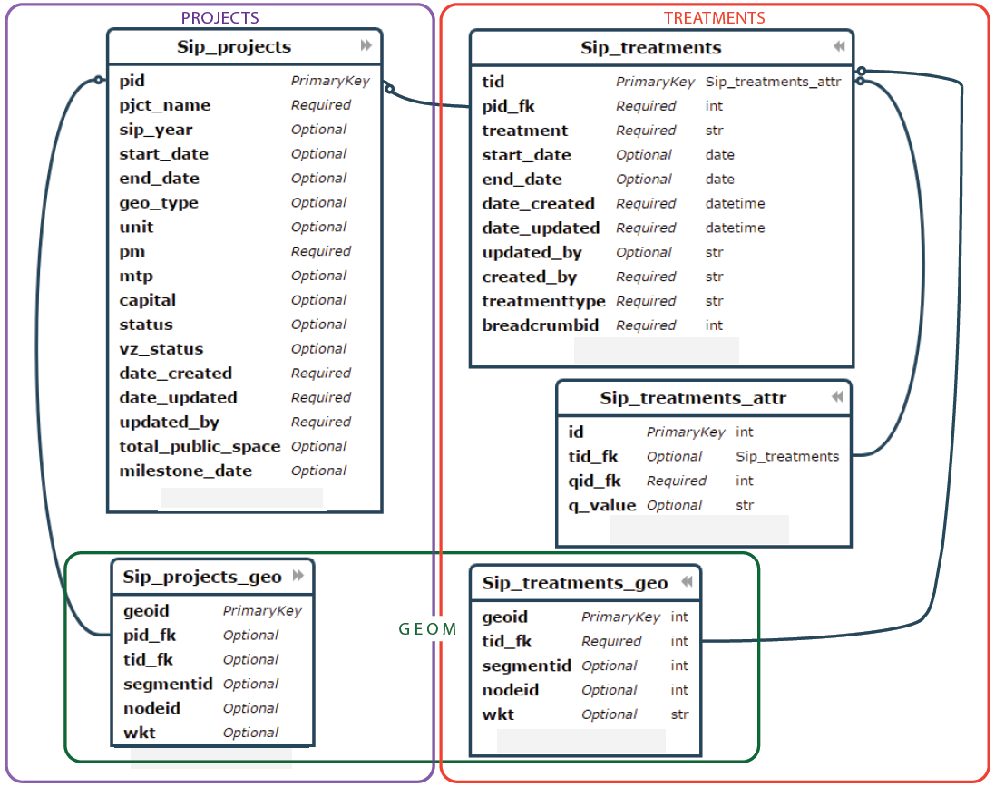
Data Schema

Slide 11
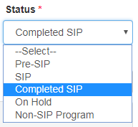
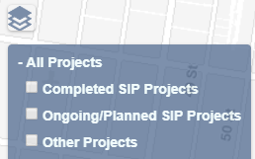
Data Entry Rules

Slide 12
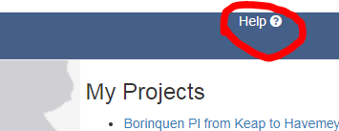
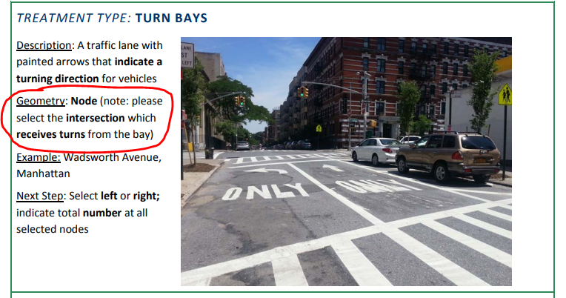
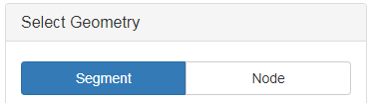
Data Entry Rules
Segments or Nodes – Never both!

Slide 13
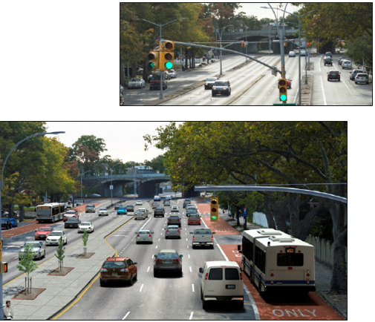
Data Entry Rules
Accounting/Balance Sheet Rule!
To add space for something, you have to take space away from something else.
For example:
Standard Bike Lane + Narrowed Lane
Pedestrian Plaza + Street Closure
SBS Bus Lane + Lane Removal

Slide 14
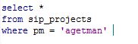
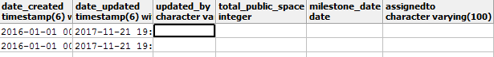
Basic Queries
Project Level

Slide 15
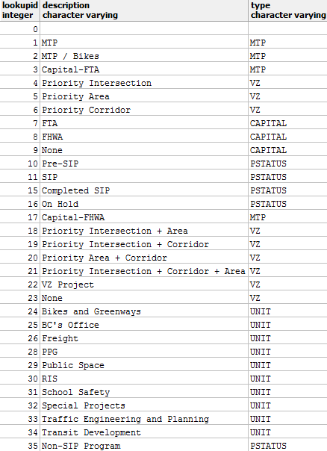
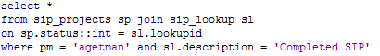
Basic Queries
Project Level – SIP Lookup Table

Slide 16
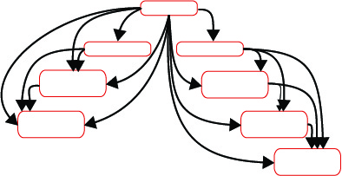
Treatments
Project
Hierarchical database model
Flexibility for treatment complexity
Simplified storage needs
Requires planning treatment relationships
Treatment 1
Treatment 2
Treatment 1
Detail 1
Treatment 2
Detail 1
Treatment 1
Detail 2
Treatment 2
Detail 2
Treatment 2
Detail 3

Slide 17
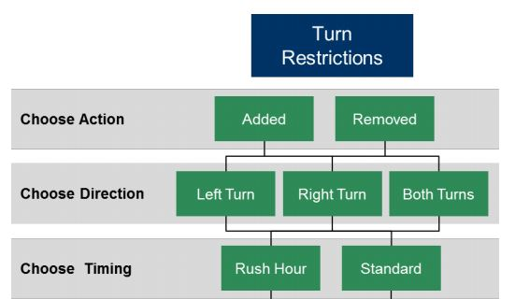
Treatments
Tree/Family Structure
Each node is a question with its own ID (QID)
The question at the level above it is it’s parent
Below are it’s children
Treatments can have varying levels of detail

Slide 18
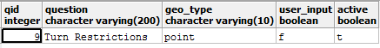
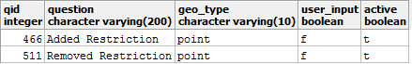
Treatments
Questions Table = Leaves on tree

Slide 19
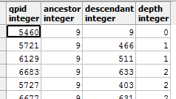
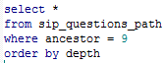
Treatments
Questions Path = Branches between leaves
Relationships between questions are stored in a questions path table
Parent = Ancestor
Child = Descendant
Depth = Generations between the two

Slide 20
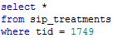
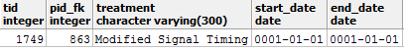
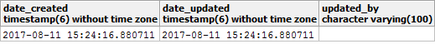
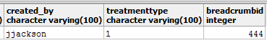
Treatments
Example: Recorded Treatment
Contains tid, pid, timestamps
Treatment type = Ultimate Ancestor
Breadcrumbid = Last treatment id descendant
Tid ties to treatment geo table and treatment attributes table

Slide 21
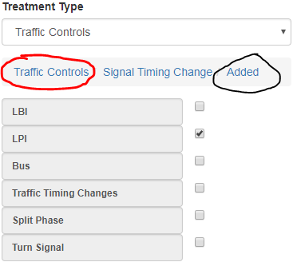
Treatments
Example: Recorded Treatment
Contains tid, pid, timestamps
Treatment type = Ultimate Ancestor
Breadcrumbid = Last treatment id descendant
Tid ties to treatment geo table and treatment attributes table

Slide 22
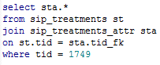
Treatments
Treatment Attributes Table
At the bottom of the tree there is a user input, recorded in treatments attribute table
Either Boolean or text
All options are written to db

Slide 23
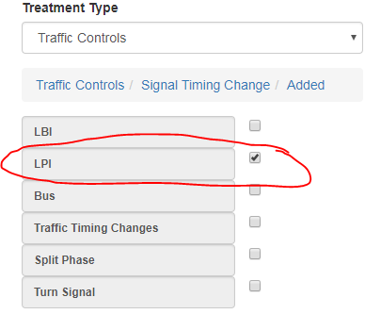
Treatments
Treatment Attributes Table
At the bottom of the tree there is a user input, recorded in treatments attribute table
Either Boolean or text
All options are written to db

Slide 24
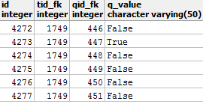
Treatments
Treatment Attributes Table
At the bottom of the tree there is a user input, recorded in treatments attribute table
Either Boolean or text
All options are written to db

Slide 25
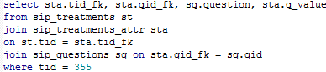
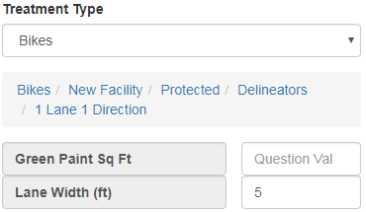
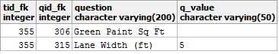
Treatments
Treatment Attributes Table

Slide 26
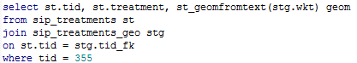
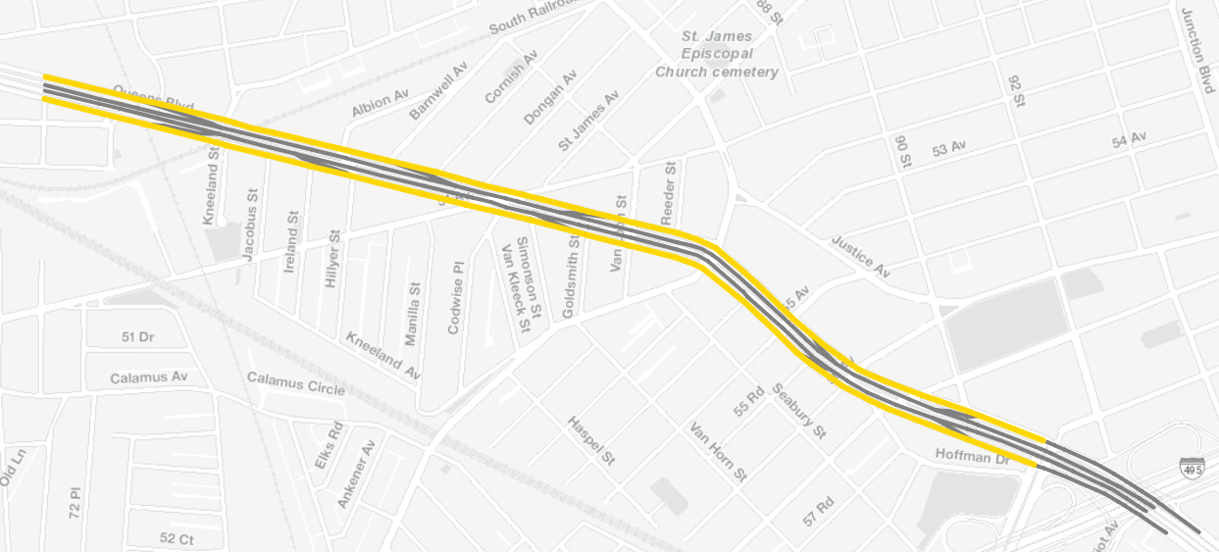
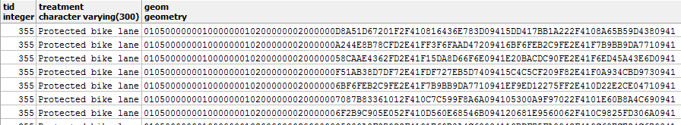
Treatments
Treatment Geo Table

Slide 27
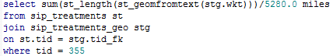
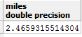
Be careful!
Treatment Geo + Attribute Table

Slide 28
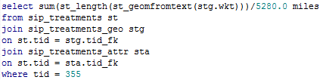
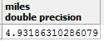
Be careful!
Treatment Geo + Attribute Table

Slide 29
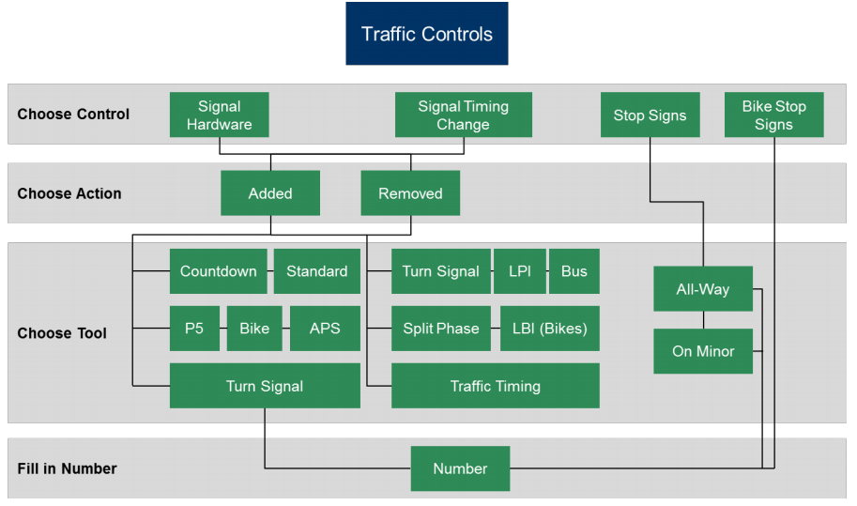
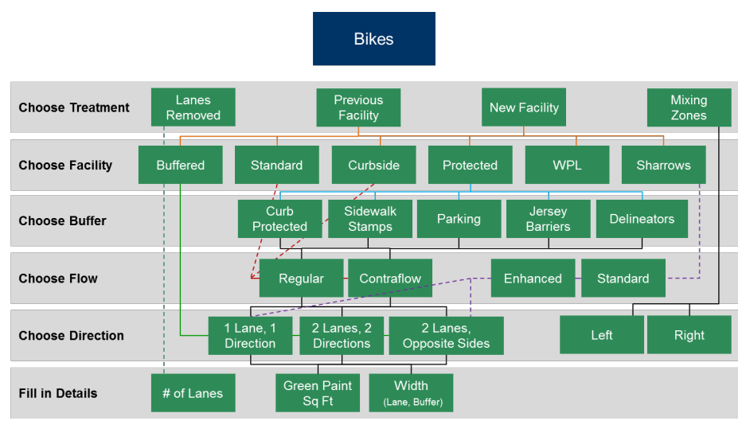
Treatments… get complex

Slide 30
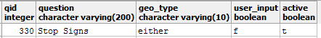
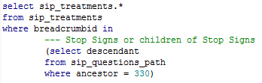

Treatments Queries – Parents Always Bring Their Children!
Query for “Stop Signs”

Slide 31

Be Careful!
Query for “Protected Bike Lanes”

Slide 32


Be Careful!
Query for “Protected Bike Lanes”

Slide 33


Geometry Queries
SIP CLION
CLION + Political Boundaries

Slide 34


Geometry Queries
Completed 2018 Projects in MN CB 1 (where we work)

Slide 35

Project search
Project Search function returns project extents + attributes
Can also search by political boundaries and treatments
Returns project list + map
Can output csv of list

Slide 36





Thank you!
Questions?
NYCDOT
nyc_dot
nyc_dot
NYCDOT

